Slide 1
Step 1. Introduce Root and Key Word
Listen and repeat.
What do these words have in common?
Notes:
Say: Today we are going to learn a root, and a key word to help us remember that root.
Do: Say each of the following words and have students repeat each word: describe, prescribe, subscriber, inscribe, transcribe, ascribe, scribe.
Say: What do they have in common?
Students Respond: Scribe!

Slide 2
Words with Scribe: What do you notice about these words?
Words with scribe:
describe
prescribe
subscriber
inscribe
transcribe
scribe
What do you notice
about these words?
description
scribe, scrib, script all are forms (or variants) of the same root, which means “to write.”
prescription
subscription
inscription
transcript
script
scribble
Notes:
Say: Yes, they all have “scribe” in common. This is a Latin root, and it has a meaning. When we know the meaning of “scribe” it helps us know the meaning of many, many words. What do we notice about these words?
Do: Click to animate one at a time, and read chorally.
Say: Yes, they are different forms (or variants) of the same root! scrib, scribe, and script all mean “to write.”

Slide 3
Add the Root to your Personal Dictionary
Key Word- Meaning | Prefix-Meaning Negative (N) Direction (D) Intensify (I) | Root (Variants) | Root Meaning | Sample Sentence
 |  | scribe, scrib, script
Word | Prefix (N/D/I) | Meaning | Sentence
1.
2.
3.
4.
5.
6.

Slide 4
Key Words: describe, description
Repeat after me:
described the process
how to best describe
accurately describes
describing his behavior
provide a description
he matches the description
job description
brief description
Notes:
Say: The words that we’re going to analyze today are “describe and description.” You may be familiar with this word, but we’re going to analyze the morphemes, or meaningful parts in these words. We’re going to call this our key word because if we ever forget what the root “scribe/script” means, we can think of these words to help us remember. Please repeat after me the many ways that we commonly hear these words.
Do: Read each phrase and have students repeat.

Slide 5
Add the Key Word to your Personal Dictionary
Key Word- Meaning | Prefix-Meaning Negative (N) Direction (D) Intensify (I) | Root (Variants) | Root Meaning | Sample Sentence
describe/ description |  | scribe, scrib, script
Word | Prefix (N/D/I) | Meaning | Sentence
1.
2.
3.
4.
5.
6.

Slide 6
How well do you know the words describe & description?
1- I don’t know them.
2- I’ve heard/seen them, but I don’t know the exact meaning.
3- I can use them in a sentence.
4- I can analyze them and explain the root and affix meaning.
Notes:
Say: We do this to access our prior knowledge about a word. There are many different levels of knowing a word. For example, there are words I may understand when I’m reading, but I don’t know them well enough to use it in a conversation.
Do: Read what each number stands for and have students hold up a finger to rate their knowledge.
Say: Great! I see many different levels. Let’s get everyone to a 4!

Slide 7
de= down (also of, from) scribe/script= to write, written describe- to write down description- written down
Meaning: If we describe something we may tell or write about it using words. A description may be something oral or written about a person, place, thing, action, feelings, etc.
Let’s look at some examples…
Notes:
Say: Our key word is made up of a prefix, de and a root scribe/script. They each have meanings. de means “down.” scribe/script means to write, or written. So the literal definition is to write or written down. Now that is a very literal analysis of the two morphemes in the words, but we know that this word has a more detailed meaning.
Do: Read meaning to students.

Slide 8
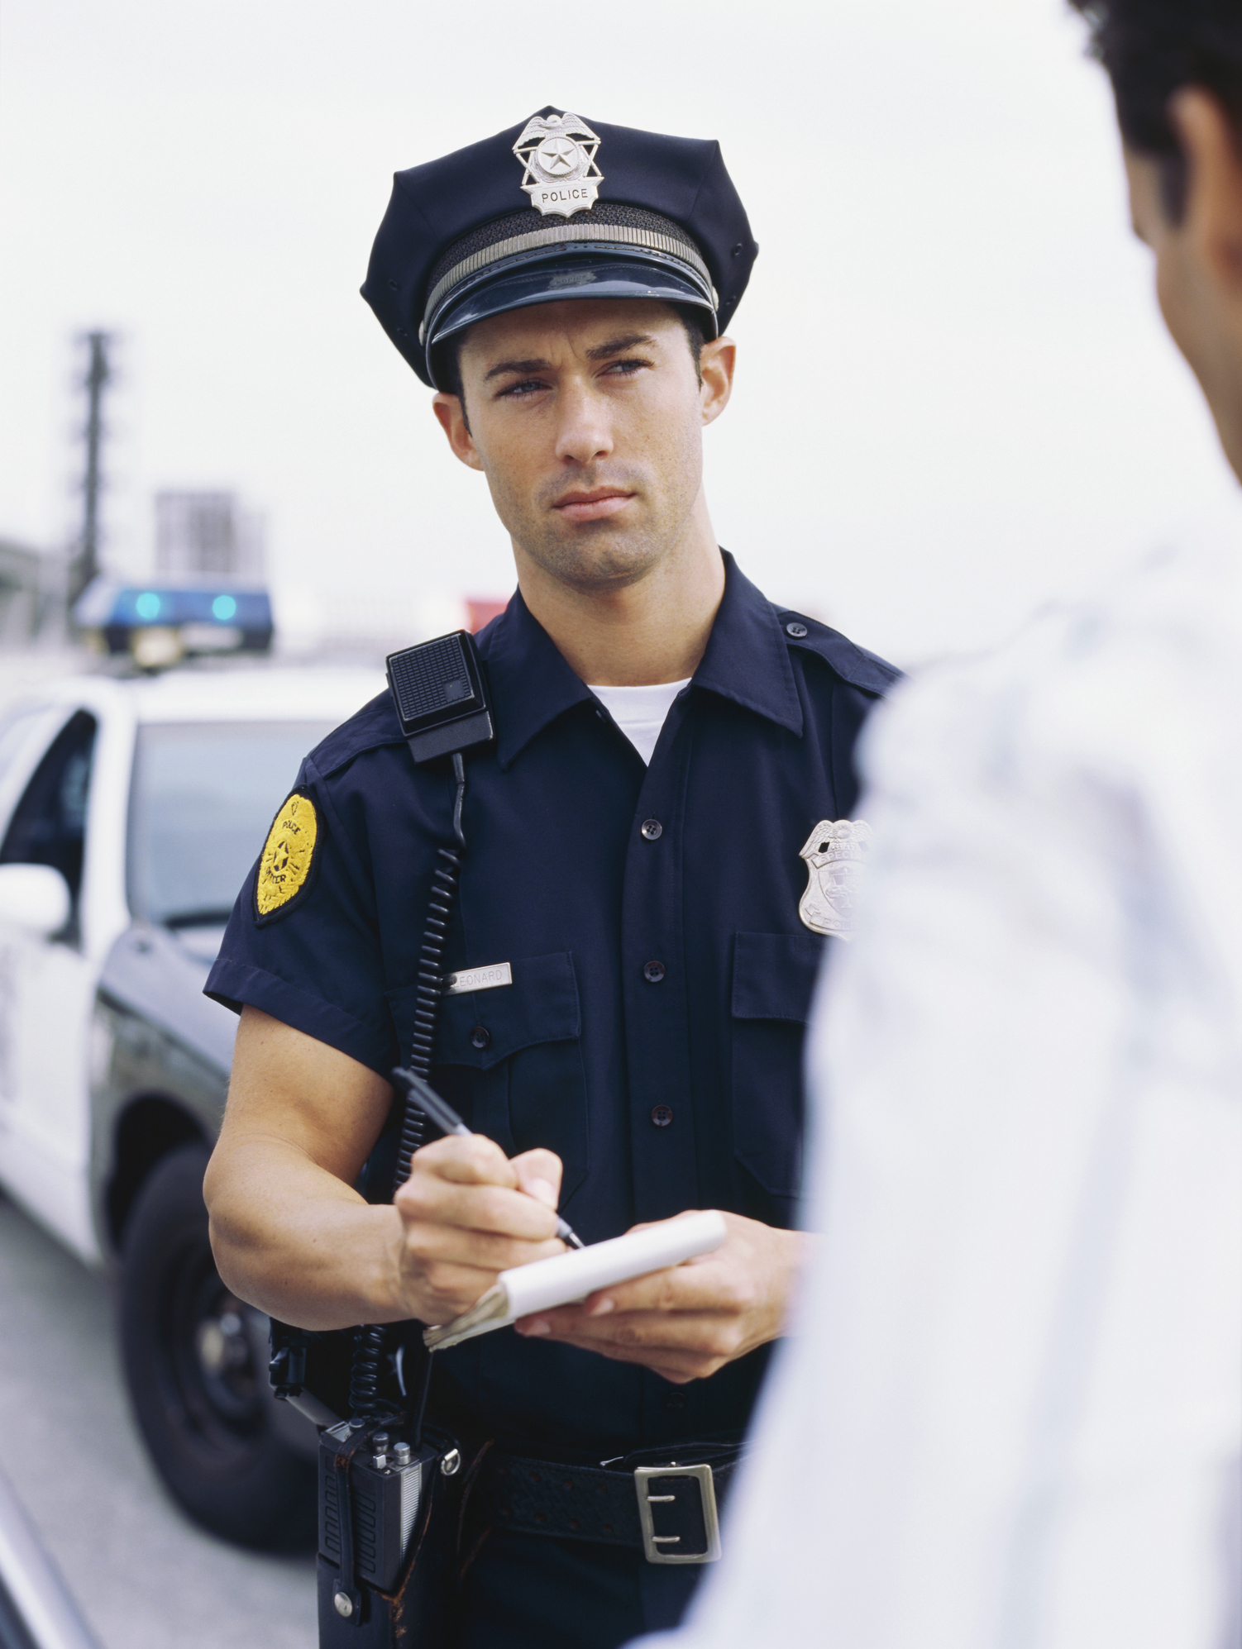
describe description de= down scribe/script= write/written
If you witness someone commit a crime, a police officer may ask you to describe the person you saw.
I found the perfect job description in
the newspaper.
What do you think a job description
for a principal would say?
The officer will have to file the description as part of his report.
A job description
for a principal would describe
someone who is____________.
Notes:
Do: Talk about the examples, and how the denotation of the word is written down or to write down. The job description is written down, the police officer is asking you to describe in words so she can write down, she is turning in he description. After you read the sentences as a class you may have someone read the sentence aloud. Ask follow up questions.
Say: What do you think a job description for a ________ would say?
Do: Come up with different jobs.

Slide 9
What does describe/description mean? What does scribe/script mean? What does the prefix de mean/do?
Key Word- Meaning | Prefix-Meaning Negative (N) Direction (D) Intensify (I) | Root (Variants) | Root Meaning | Sample Sentence
describe/ description To write down Written down | de-down (Directional) | scribe, scrib, script | to write written
Word | Prefix (N/D/I) | Meaning | Sentence
1.
2.
3.
4.

Slide 10
Related/Unrelated
Related | Unrelated
I copy definitions from the back of
my textbook.
A friend asks me what I think of a girl.
I laugh and walk away.
A question in my textbook says to write
about the process of photosynthesis.
A police officer writes me a ticket
for speeding.
My favorite sport.
A video game.
My teacher tells me how to solve a math
problem, and I take notes.
A multiple choice test.
________________ is (related/unrelated) to (describing/a description) because ______________________________.
Notes:
Do: Divide the class into teams. Give them 5 minutes to gather their thoughts. Each team gets a chance to earn a point. To earn a point they must select an item and say whether it is related to (describing/a descritpion) or unrelated and why. The teacher should move the item into the correct side of the table. Tell them to prepare three answers for various prompts.
Say: The purpose of this activity is to think about how we use words. There may be more than one right answer. Be sure you can justify your response. For example, I might say “A multiple choice test is unrelated to describing because I do not have to write about or tell about anything I just have to choose the right answers.”

Slide 11
Let’s add a sample sentence!
Key Word- Meaning | Prefix-Meaning Negative (N) Direction (D) Intensify (I) | Root (Variants) | Root Meaning | Sample Sentence
describe/ description To write down Written down | de-down (D) | scribe, scrib, script | to write written | I lost my cat, so I needed to provide a description to the animal shelter.
Word | Prefix (N/D/I) | Meaning | Sentence
1.
2.
3.
Choose from the following frames:
a. I’m writing for the school paper, and I have to describe ______________________________.
b. I lost my _________________, so I needed to provide a description to the _______________.
c. My teacher asked me to describe ________________________ for _____________________.

Slide 12
How well do you know the words describe & description?
Next time, we’ll look at all the different words we can make using roots: scribe, scrib, script!
And if we forget what those roots mean, what are our key words?
1- I don’t know them.
2- I’ve heard/seen them, but I don’t know the exact meaning.
3- I can use them in a sentence.
4- I can analyze them and explain the root and affix meaning.
Notes:
Say: Now how well do you know the words describe and description.
Do: Read what each number stands for and have students hold up a finger to rate their knowledge.
Say: Great! Hopefully we’re all at 4!
Do: Click animation and read slide.

Slide 13
The contents of this presentation were developed under a State Personnel Development Grant (SPDG) from the US Department of Education (CALI/Award #H323A170011), Project Officer, Latisha.Putney@ed.gov. However, the contents of this presentation do not necessarily represent the policy of the US Department of Education and no assumption of endorsement by the Federal government should be made.

